Slide 1
Regression with Neural Network
By Harish Gampala (4752)
Trainee Data Scientist at Turingminds.ai

Slide 2
Contents
Types of learning
Machine Learning Vs Neural network
Neural Network
Artificial Neural Network
Perceptron and Multi-Level Perceptron
Mathematics behind Neural Network
Weight Initialization
Activation functions
Optimizers
Flowchart

Slide 3
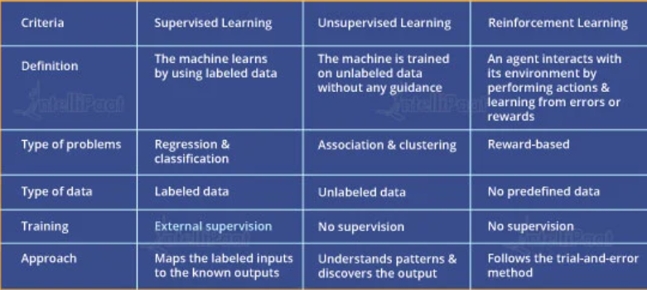
Types of Learning

Slide 4
Machine Learning Vs Neural Network
The choice between using a neural network or a traditional machine learning model depends on the problem being solved and the available data.
When the amount of data is increased, ML technology is not sufficient in terms of performance but neural network gives better performance.
Why we need choose a neural network over other machine learning models:
Complex non-linear relationships
Large amounts of data
Unstructured data
Real-time predictions

Slide 5
Neural Network
Neural networks are a type of machine learning algorithm inspired by the structure of the human brain.
They are used for a variety of tasks, regression, including image classification, natural language processing and speech recognition.
It is a type of supervised learning . It involves using neural networks to predict a continuous numerical value.
It can be used for a wide range of applications, like prediction of stock prices, weather forecasting, and disease diagnosis.

Slide 6
Artificial Neural Network
It is used to mimic the basic functioning of the human brain and are inspired by how it interprets the information.
It solves the real time problems very efficiently and effectively.
FIG(1) : Neural Network
It is useful in facial and voice recognization and google lens.
Nodes
Bias
x1
Y=f( Σ w⋅x+bias)
w1
Weights
x2
w2
x3
w3
Σ f(x)
Y
Output
w4
x4
Input
Activation Function

Slide 7
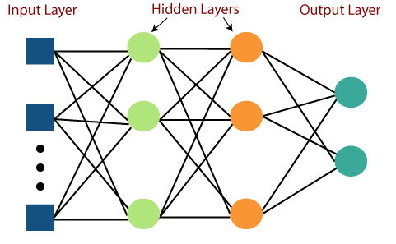
Perceptron and Multi-Level-Perceptron
Perceptron : It is a type of artificial neural network model that learns to classify input data by adjusting the weights of its inputs to produce an output.{fig:1}
A perceptron is a artificial neuron.
Single layer perceptron does not work well for non-linear data.
Multi-Level-Perceptron : It is a fully connected neural network.
It means one layer neuron is connected with all the neurons in the next layer is called as dense.

Slide 8
Mathematics behind Neural Network
Neural networks can be quite complex and involve various branches of mathematics such as
Linear algebra (matrix multiplication, dot product, and vector )
Calculus (computing gradients of cost function)
Probability theory(predicting output by using Activation function)
Optimization (minimizing error by optimization techniques)
Forward propagation
Back propagation.

Slide 9
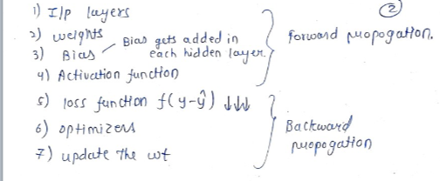
Forward and Backward propagation
Forward propagation is the process of computing the output of a neural network for a given input.
Back propagation is the algorithm used to train a neural network by adjusting the weights of the connections between its neurons to reach the minimized the loss function. It is done by chain rule of differentiation.

Slide 10
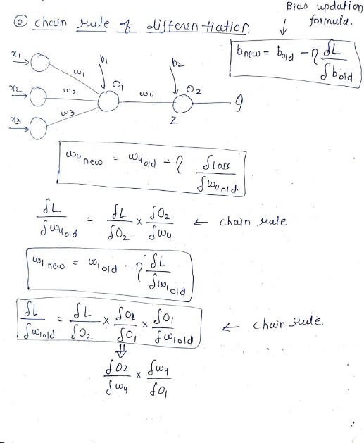
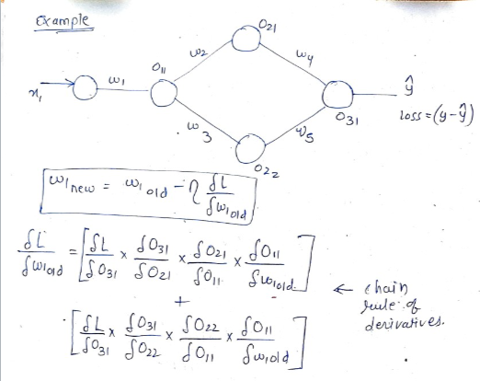
Backward Propagation
Chain rule of differentiation
Example

Slide 11
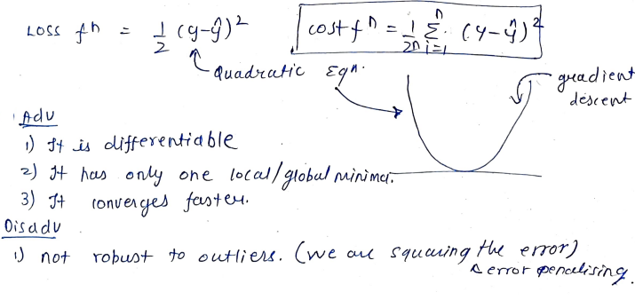
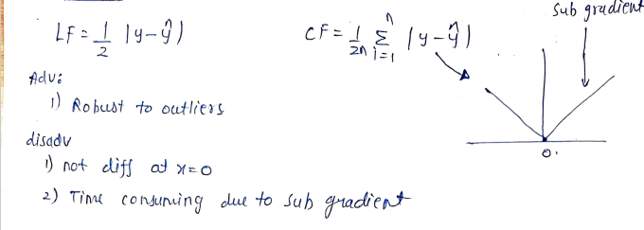
Loss Vs Cost function in Regression metrics
1.Mean Square Error
2.Mean Absolute Error

Slide 12
Weight Initialization
This methods are used to set the initial values of the weights in a neural network
The weights of a neural network determine how it transforms input data into output data, and as a result, they play a crucial role in the performance of the network.
poorly
lead to problems, such as vanishing or exploding gradients.
To overcome this problems we use weight initialization methods like
Xavier / Glorot initialization
He initialization.
The choice of weight initialization method depends on the architecture of the neural network, the activation function being used

Slide 13
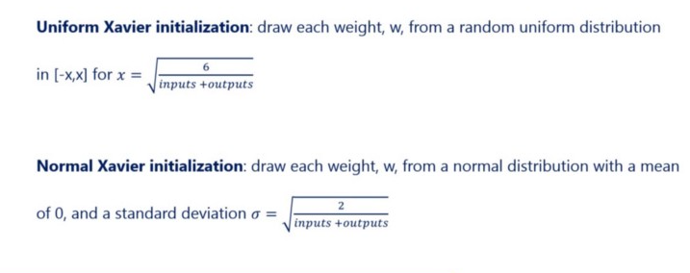
1.Xavier / Glorot Initialization
It sets layer’s weights to values chosen from a Random distribution that’s bounded between
2.He Initialization
Similar to the Xavier Initialization method.
This methods are initialized by
kernel_initializer='glorot_uniform/normal’(or)’he_unifrom/normal’

Slide 14
Application Programming Interfaces
Neural network APIs can make it easier and more efficient to develop, train, and deploy neural network models.
Some popular neural network APIs include Keras, TensorFlow, and PyTorch.
It provide’s a high-level interface for building and training neural networks
Keras is a high-level neural network API in Python
Sequential API: where each layer in the model is connected to the layer that precedes it and the layer that follows it, in a sequential order. model = Sequential()
Functional API: It allows for more complex model architectures, including models with multiple inputs and outputs, shared layers, and residual connections.

Slide 15
Activation Functions
It is a mathematical function that is applied to the output of each neuron, whether it should be activated (or) not.
It introduces non-linearity to solve real world problems.
Commonly used activation functions are:
Sigmoid function
Softmax function
Hyperbolic Tangent function
Relu function
Leaky Relu function
P Relu function
Selecting the right activation function it impact’s on the performance of a neural network.

Slide 16
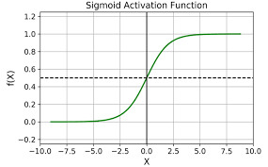
Sigmoid function
It maps any input to a value between 0 and 1.
It is often used as an output activation function in binary classification problems.
F(x)= 1/1+e^{-x}
Advantages:
Normalize
Continuous and differentiable
Works well for back propagation.
Drawbacks:
Vanishing gradient problem.
Failed to solve multiclassification problems.
{to overcome this we use “softmax”}

Slide 17
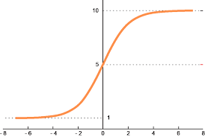

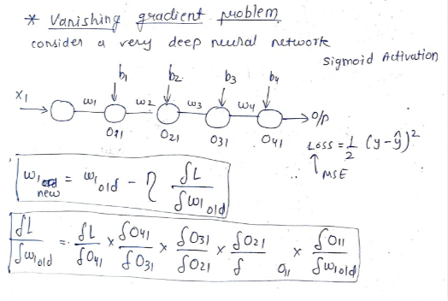
Softmax function
It maps any input to a value between 0 and 1.
It is commonly used in the output layer of a neural network.
It is often used in multiclass classification problems.
Similar to sigmoid function.
Drawbacks:
Vanishing gradient problem.
Computational intensive.

Slide 18
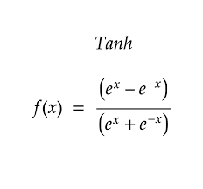
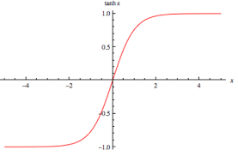
Hyperbolic Tangent function
It maps any input to a value between -1 and 1.
It is used in hidden layers of neural networks.
It is used in Binary classification.
Similar to sigmoid but converges faster than sigmoid.
It acts as a drop out layer.
Drawbacks:
Vanishing gradient problems.

Slide 19
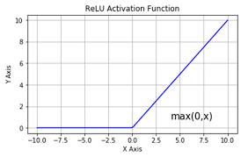
Rectified Linear Unit function
ReLU function returns the input value if it is positive, and 0 otherwise.
It is used in deep neural networks due to its simplicity and effectiveness.
f(x) = max(0,x)
Act as a dropout layer also
Overcomes the vanishing gradient problems.
Drawback:
It is not differentiable at zero.
So during back propagation no learning occurs for the input .
{to overcome we use Leaky Relu used}

Slide 20
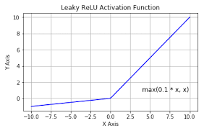
Leaky Relu function
The leaky ReLU function addresses a potential problem known as "dying ReLU“.
It makes non-zero output for negative input values.
f(x)=max(0.01*x , x)
Solves dying Relu
Increase in accuracy
Fast convergence.
Drawback:
Learning occurs (back propagation) but it is very low.
{to overcome we use PRelu}

Slide 21
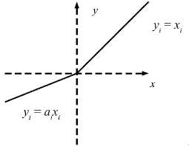
Parametric Relu function
It is similar to the leaky ReLU function
it allows the slope to be learned during the training process.
f(x) = max(ax, x)
It designed to to address the "dying ReLU" problem.
It gives better performance.
We can get the desired accuracy and faster convergence.
Increases the computational cost and risk of overfitting.

Slide 22
Optimizers
Optimizers are algorithms that are used to update the parameters of a model to minimize the loss function.
The parameters are Weights and Learning rate .
Optimizers are
Gradient Descent
Stochastic Gradient Descent
Mini Batch SGD
SGD with Momentum
Ada Grad
Ada Delta and RMS Prop
ADAM

Slide 23
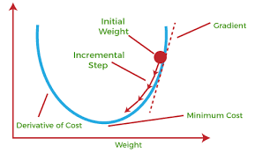
Gradient Descent
It is the most basic optimizer that updates the model weights in the direction of the negative gradient of the loss function.
It is commonly-used to train machine learning models and neural networks.
Advantages:
Minimization of loss function
Less noise
It trains whole data at once(i.e.,1epoch)
Drawback:
Large memory
It is resource extensive technique.
Convergence takes time but it updates until it reaches minimum.
Epoch: It means training neural network with full dataset in one cycle. { in Forward and Backward directions}

Slide 24
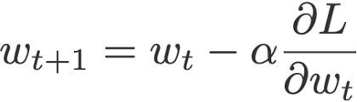
Stochastic Gradient Descent
The gradient of the cost function is computed with respect to a single training example at a time.
1epoch = 1 record = 1 iteration
The weights are updated after example.
Advantages:
Less memory
Faster and more suitable for large datasets.
Drawbacks:
Convergence will be slow.
High variance
High noisy
Time consuming.

Slide 25
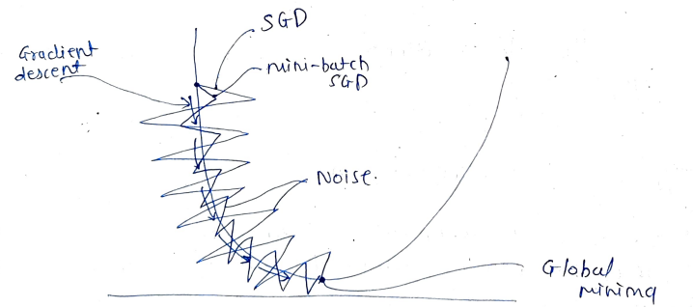
Mini Batch Stochastic Gradient Descent
The gradient is computed with respect to a small batch of training examples.
The weights are then updated based on the average gradient of the batch. {1iteration = 1epoch}
Batch size=100records,
Advantages:
Better convergence
Improve time complexity
Moderate memory
Drawbacks:
Less noise {It overcome by momentum}

Slide 26
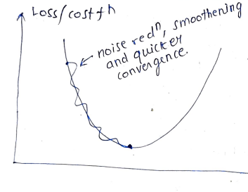
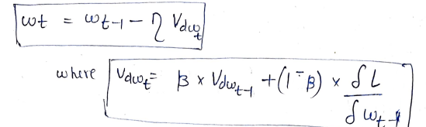
Stochastic Gradient Descent Momentum
It can converge to a local minimum instead of the global minimum, to overcome this we use momentum.
Momentum is used to eliminate noise by using exponential moving average.
Adavantages:
Reducing noise
Quick convergence
Adaptive Learning rate:It is helps us to maintain the speed of the convergence.

Slide 27
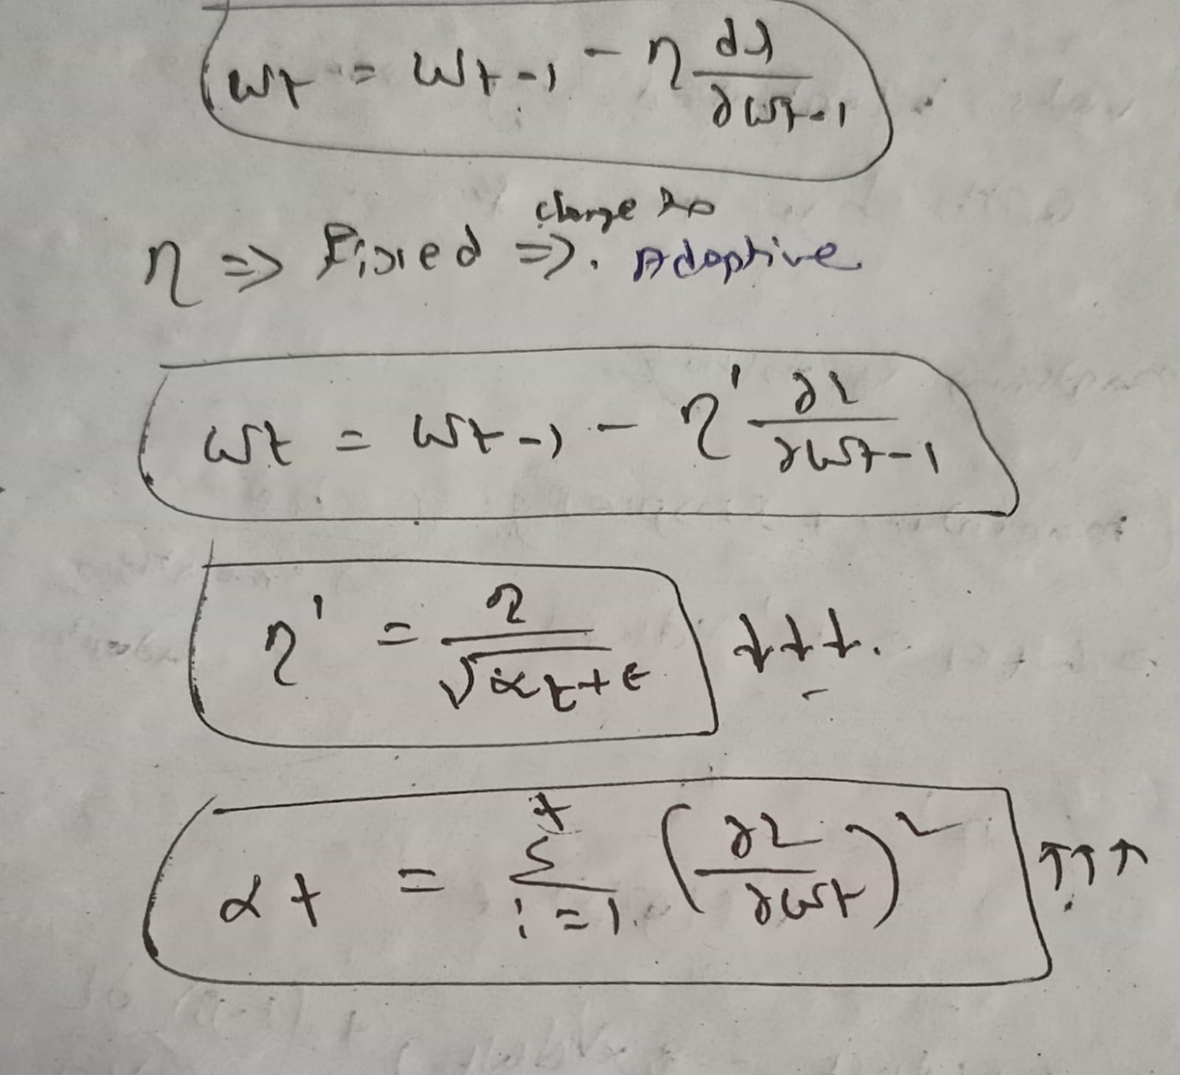
Adaptive Gradient
The learning rate is adapted component-wise to the parameters by incorporating knowledge of past observations.
Initially large learning rate will make quicker convergence, but as we approach global minima. Then the learning rate value should be reduced so, we won’t miss the global minima.
Increases with time i.e., with every epoch learning rate increases.
Drawback:
If t-value is high (large number)
than by this their will be a
negligable error.
{to over come we use
adadelta and RMS prop}.

Slide 28
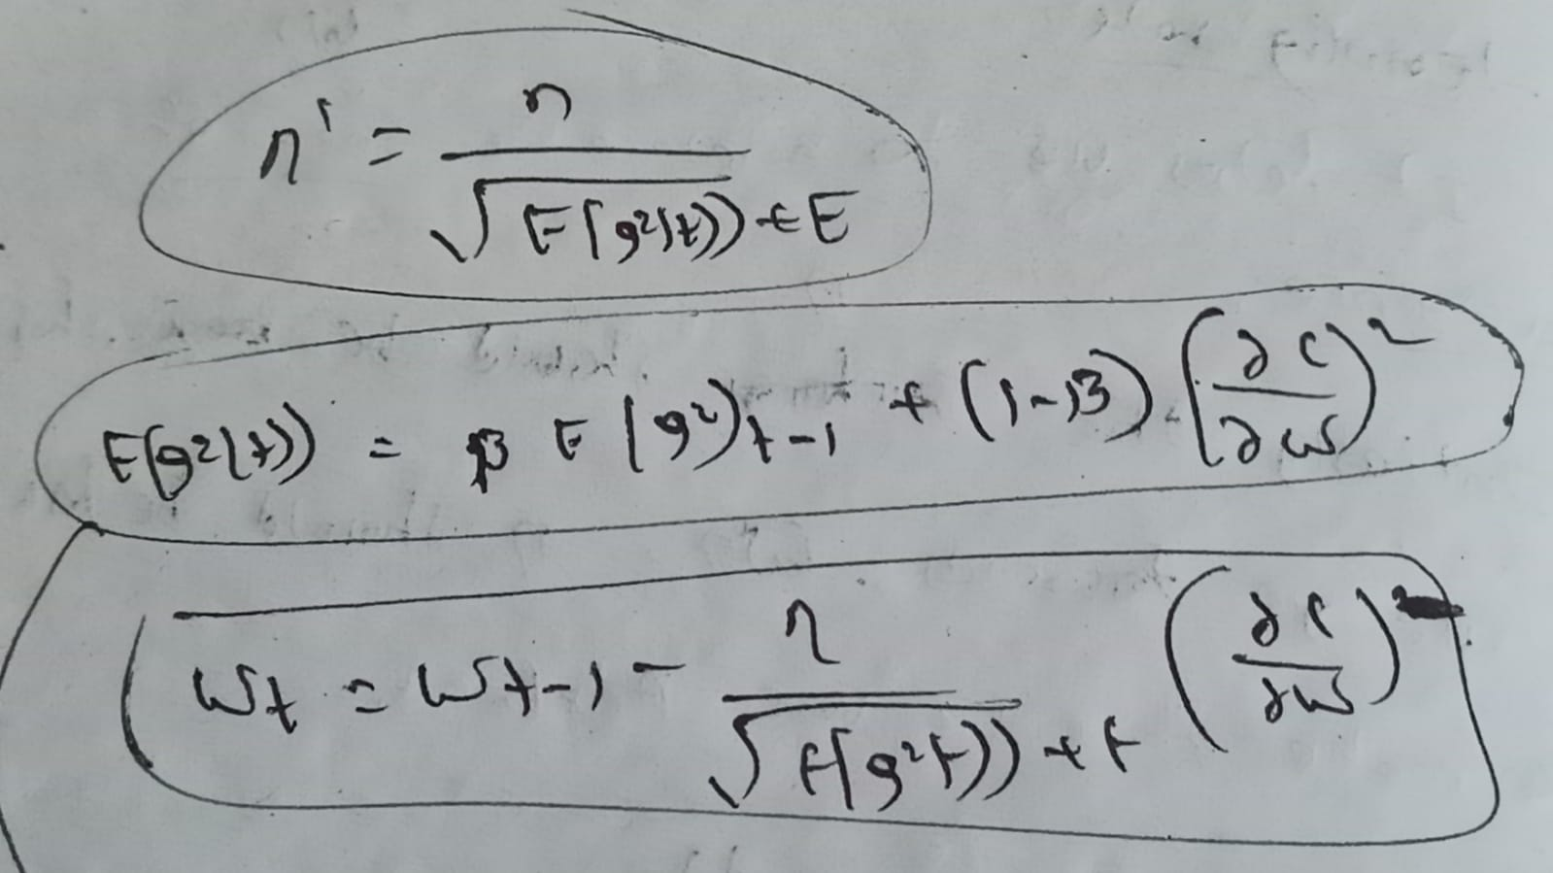
Adaptive Delta and RMS prop
RMS prop works by adjusting the learning rate
Ada delta optimizer that adjusts the learning rate based on the historical updates of the weight.
Learning rate will decrease slowly by implementing e(g2t) i.e., exponential weighted average.
To control the value of “t”(large number) by EMA.
β –hyper parameter
Drawback:
Smoothing is missing.

Slide 29
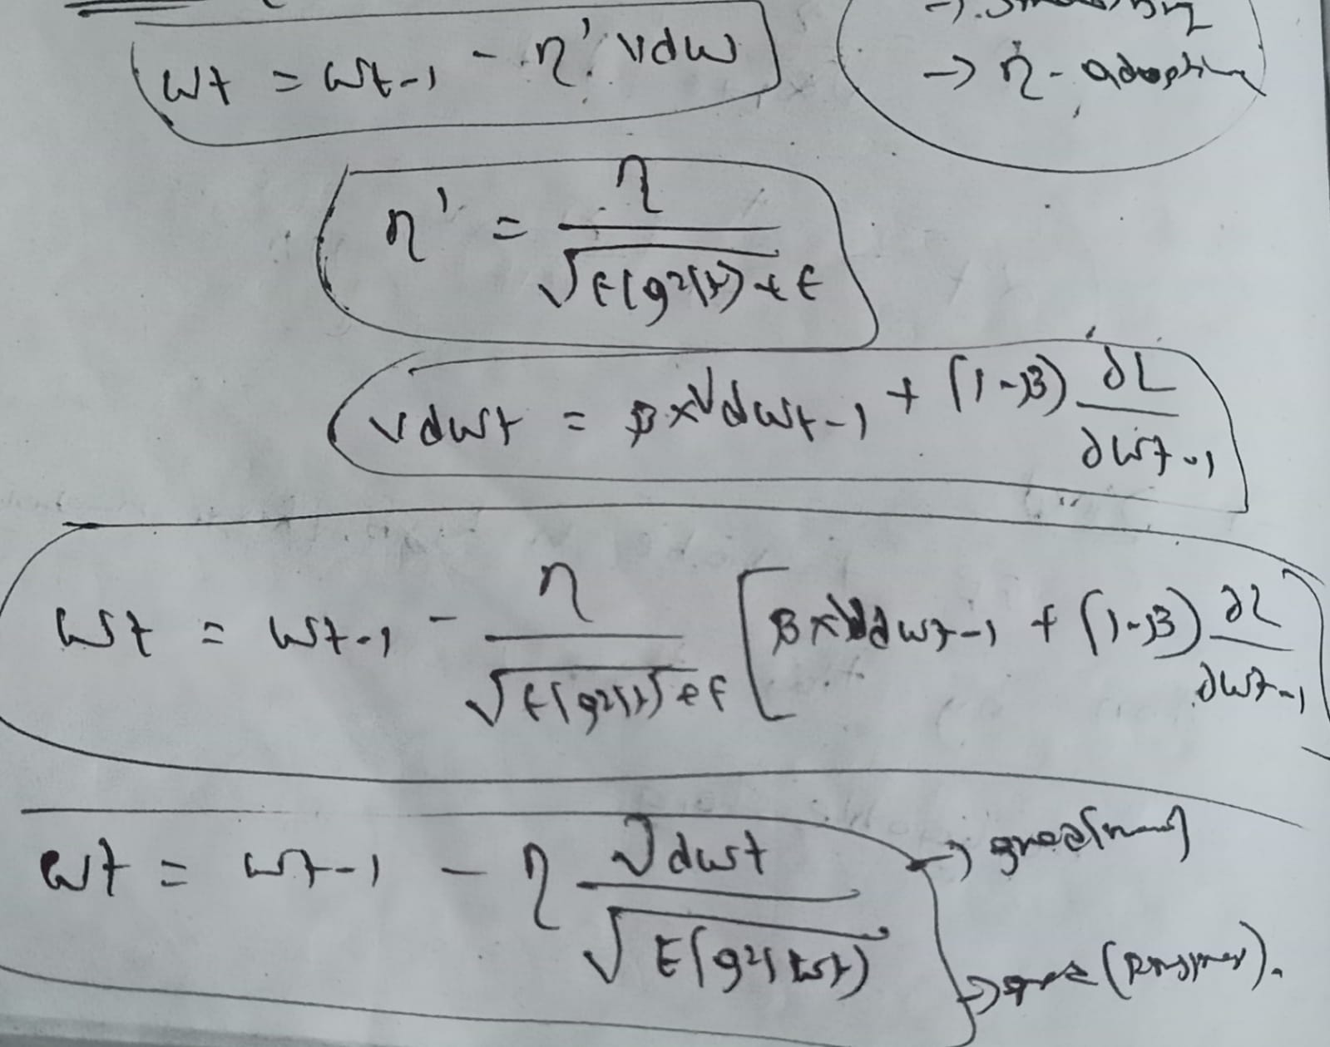
ADAM(Adaptive Moment Estimation)
It is the combination of Momentum and RMS prop.
Adam updates the weights of a neural network by minimizing the cost function.
Adam maintains exponentially decaying averages of the gradients and the squared gradients of the weight parameters.
It is well known for good performance and computational efficiency.
Advantages:
Quicker convergence
Learning rate is adaptive
Smoothing the noise.

Slide 30
Performance improvement:
Better activation
Better Initialization
Regularization
Drop out
Batch Normalization(To overcome co-variate shift problem )
{faster and more stable}
Hyperparameters:
Learning rate
Momentum
RMS prop
Epoch

Slide 31
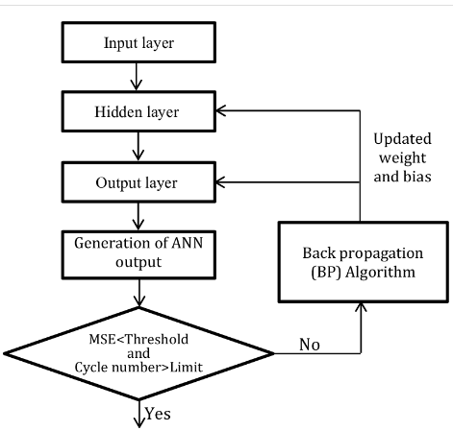
Flow chart for ANN
Blind Prediction

Slide 32


